Slide 1

UNIVERSITY INSTITUTE OF TECHNOLOGY, RAJIV GANDHI PROUDYOGIKI VISHWAVIDYALAYA BHOPAL
A
MINOR PROJECT REPORT
ON
Covid Awareness
BY
Sagar Tiwari(0101CA201026)
MCA IV SEMESTER

Slide 2
content
Introduction
Problem statement
Hardware requirement
Software requirement
Api
Php
Dataflow diagram admin
Dataflow diagram registration
Er diagram
Screenshot
Reference

Slide 3
INTRODUCTION:
Coronavirus disease 2019 (COVID-19) is an infectious disease caused by severe acute respiratory syndrome coronavirus 2 (SARS-CoV-2). It was first identified in December 2019 in Wuhan, China, and has resulted in an ongoing pandemic. The first case may be traced back to 17 November 2019. As of 8 June 2020, more than 6.98 million cases have been reported across 188 countries and territories, resulting in more than 401,000 deaths. More than 3.13 million people have recovered.
The virus is primarily spread between people during close contact, most often via small droplets produced by coughing, sneezing, and talking. The droplets usually fall to the ground or onto surfaces rather than travelling through air over long distances. Less commonly, people may become infected by touching a contaminated surface and then touching their face. It is most contagious during the first three days after the onset of symptoms, although spread is possible before symptoms appear, and from people who do not show symptoms
The virus is primarily spread between people during close contact, most often via small droplets produced by coughing, sneezing, and talking. The droplets usually fall to the ground or onto surfaces rather than travelling through air over long distances. Less commonly, people may become infected by touching a contaminated surface and then touching their face. It is most contagious during the first three days after the onset of symptoms, although spread is possible before symptoms appear, and from people who do not show symptoms.

Slide 4
PROBLEM STATEMENT:
In this project we dived deep into ‘What does data say about Covid-19 situation in India?’.
And with available data we came up with some observations and conclusions.
This analysis mainly focuses on:
✔ What is the current COVID-19 situation in India?
✔ country-wise comparison.
✔ What could be the reasons behind cases clusters found in India.
✔ Is lockdown in India successful or not?

Slide 5
Hardware Requirement
 | Window requirement | Mac requirement | Linux requirement
Operating system | Window 8 or later | macOS sierra 10.12 or later | 64-bit ubuntu 14.04+,Debian 8+,
processor | Intel Pentium 4 or later | Intel | Intel Pentium 4 or later
memory | 2 GB minimum, 4GB recommended
Screen resolution | 1280*1024 or larger
Application window size | 1024*680 or larger
 | required

Slide 6
Software requirement
Software or resources | Version required
A PHP engine | Version 5.Included in XAMPP-window.
A web server | Apache HTTP Server 2.2 is recommended. Included in XAMPP-window.
A Database server | MySQL Server 5.0 is recommended. Included in XAMPP-window.
A PHP debugger(optional) | Xdebug 2.0 or later
Text/HTML editor | 4.01 or later
Web browser
CSS,bootstrap | 3,4,or5

Slide 7
What is api ?
API is an abbreviation for Application Programming Interface which is a collection of communication protocols and subroutines used by various programs to communicate between them. A programmer can make use of various API tools to make its program easier and simpler. Also, an API facilitates the programmers with an efficient way to develop their software
Real life example of an API: Suppose, we are searching for a hotel room on an online website. In this case, you have a vast number of options to choose from and this may include the hotel location, the check-in and check-out dates, price, accommodation details and many more factors. So in order to book the room online, you need to interact with the hotel booking’s website which in further will let you know if there is a room available on that particular date or not and at what price. Now in the above example, the API is the interface that actually communicates in between. It takes the request of the user to the hotel booking’s website and in turn returns back the most relevant data from the website to the intended user

Slide 8
PHP: Hypertext Preprocessor
PHP is a server scripting language, and a powerful tool for making dynamic and interactive Web pages.
PHP is a widely-used, free, and efficient alternative to competitors such as Microsoft's ASP.
What is a PHP File?
PHP files can contain text, HTML, CSS, JavaScript, and PHP code
PHP code is executed on the server, and the result is returned to the browser as plain HTML
PHP files have extension ".php"
What Can PHP Do?
PHP can generate dynamic page content
PHP can create, open, read, write, delete, and close files on the server
PHP can collect form data
PHP can send and receive cookies
PHP can add, delete, modify data in your database
PHP can be used to control user-access
PHP can encrypt data
With PHP you are not limited to output HTML. You can output images, PDF files, and even Flash movies. You can also output any text, such as XHTML and XML.

Slide 9
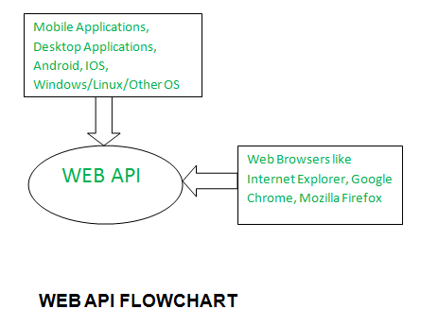
Web api is used in this project
A Web API also called as Web Services is an extensively used API over the web and can be easily accessed using the HTTP protocols. A Web API is an open source interface and can be used by a large number of clients through their phones, tablets. or PC’s.

Slide 10
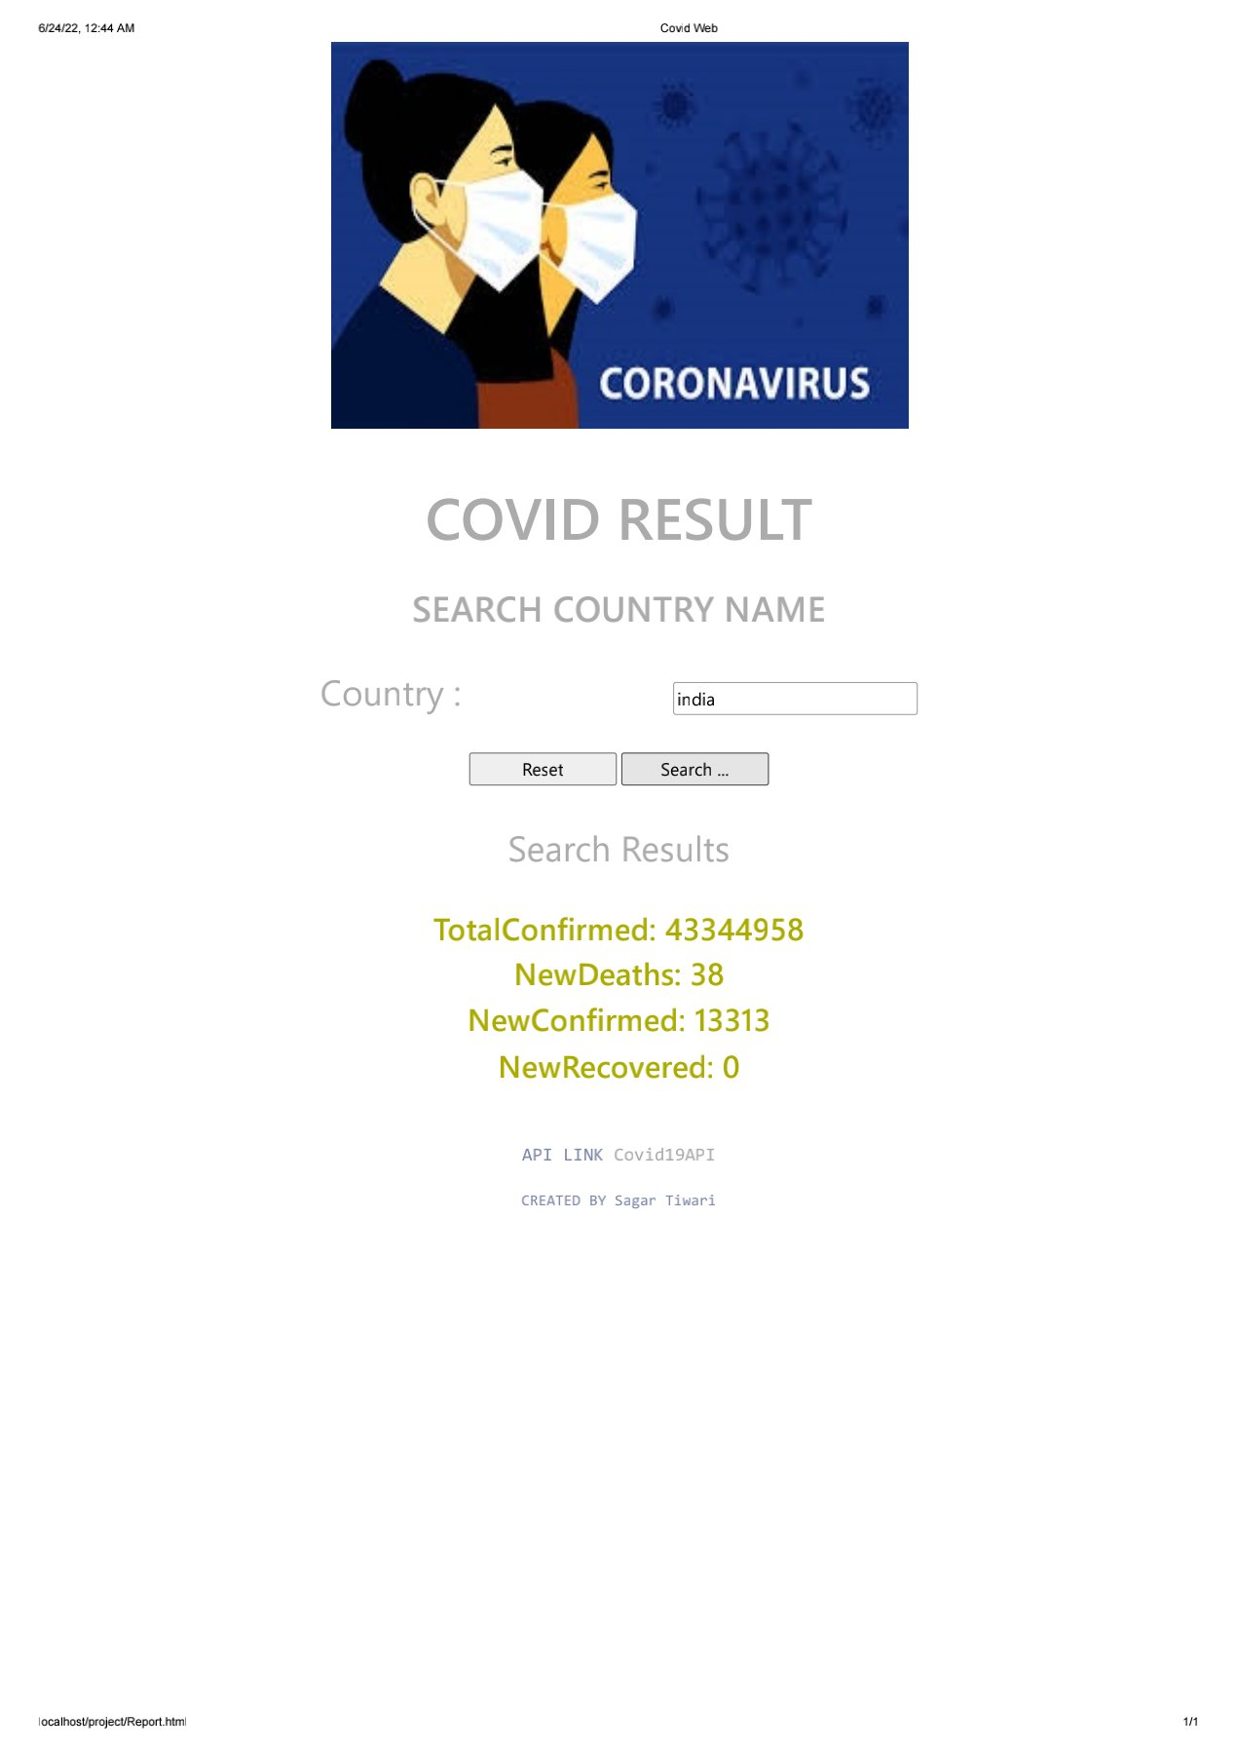

Slide 11
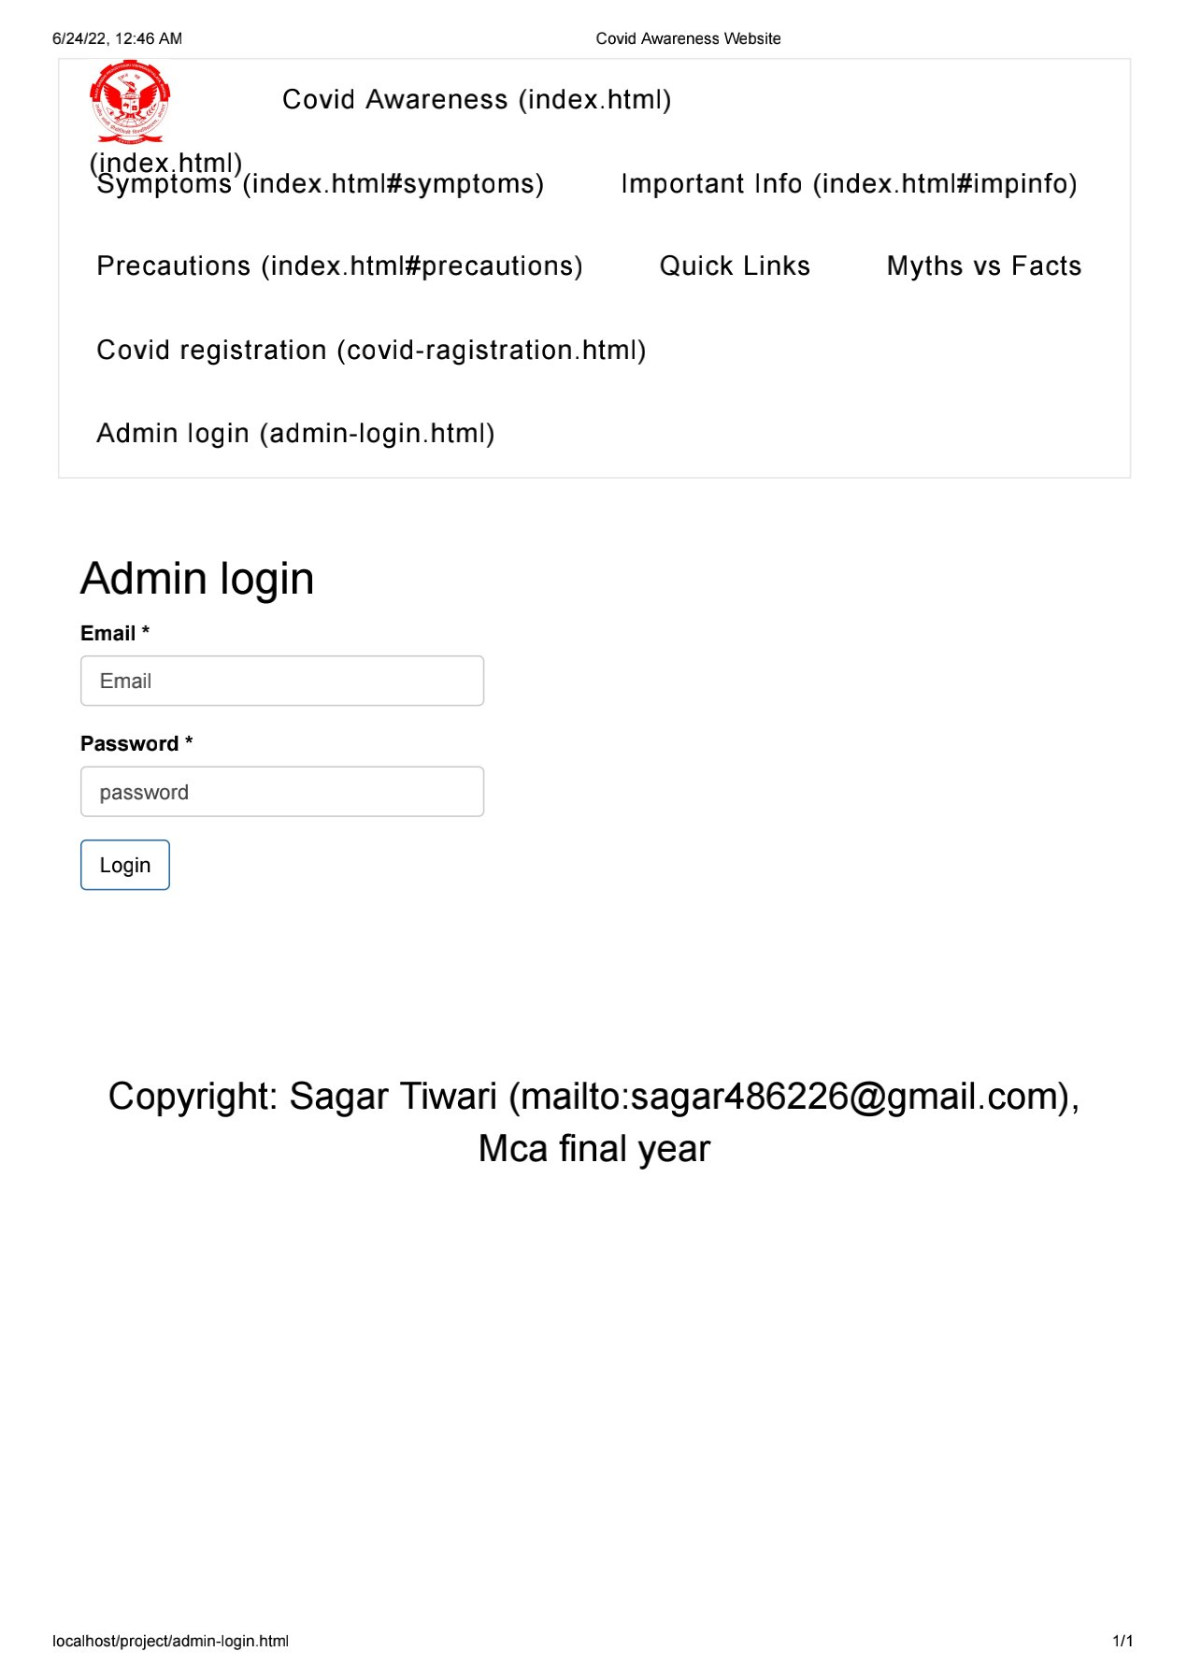
Dataflow diagram on admin login
start
Enter to the admin login
Enter email and password
Email and password valid
not
Wrong information
Logged into the system
End

Slide 12
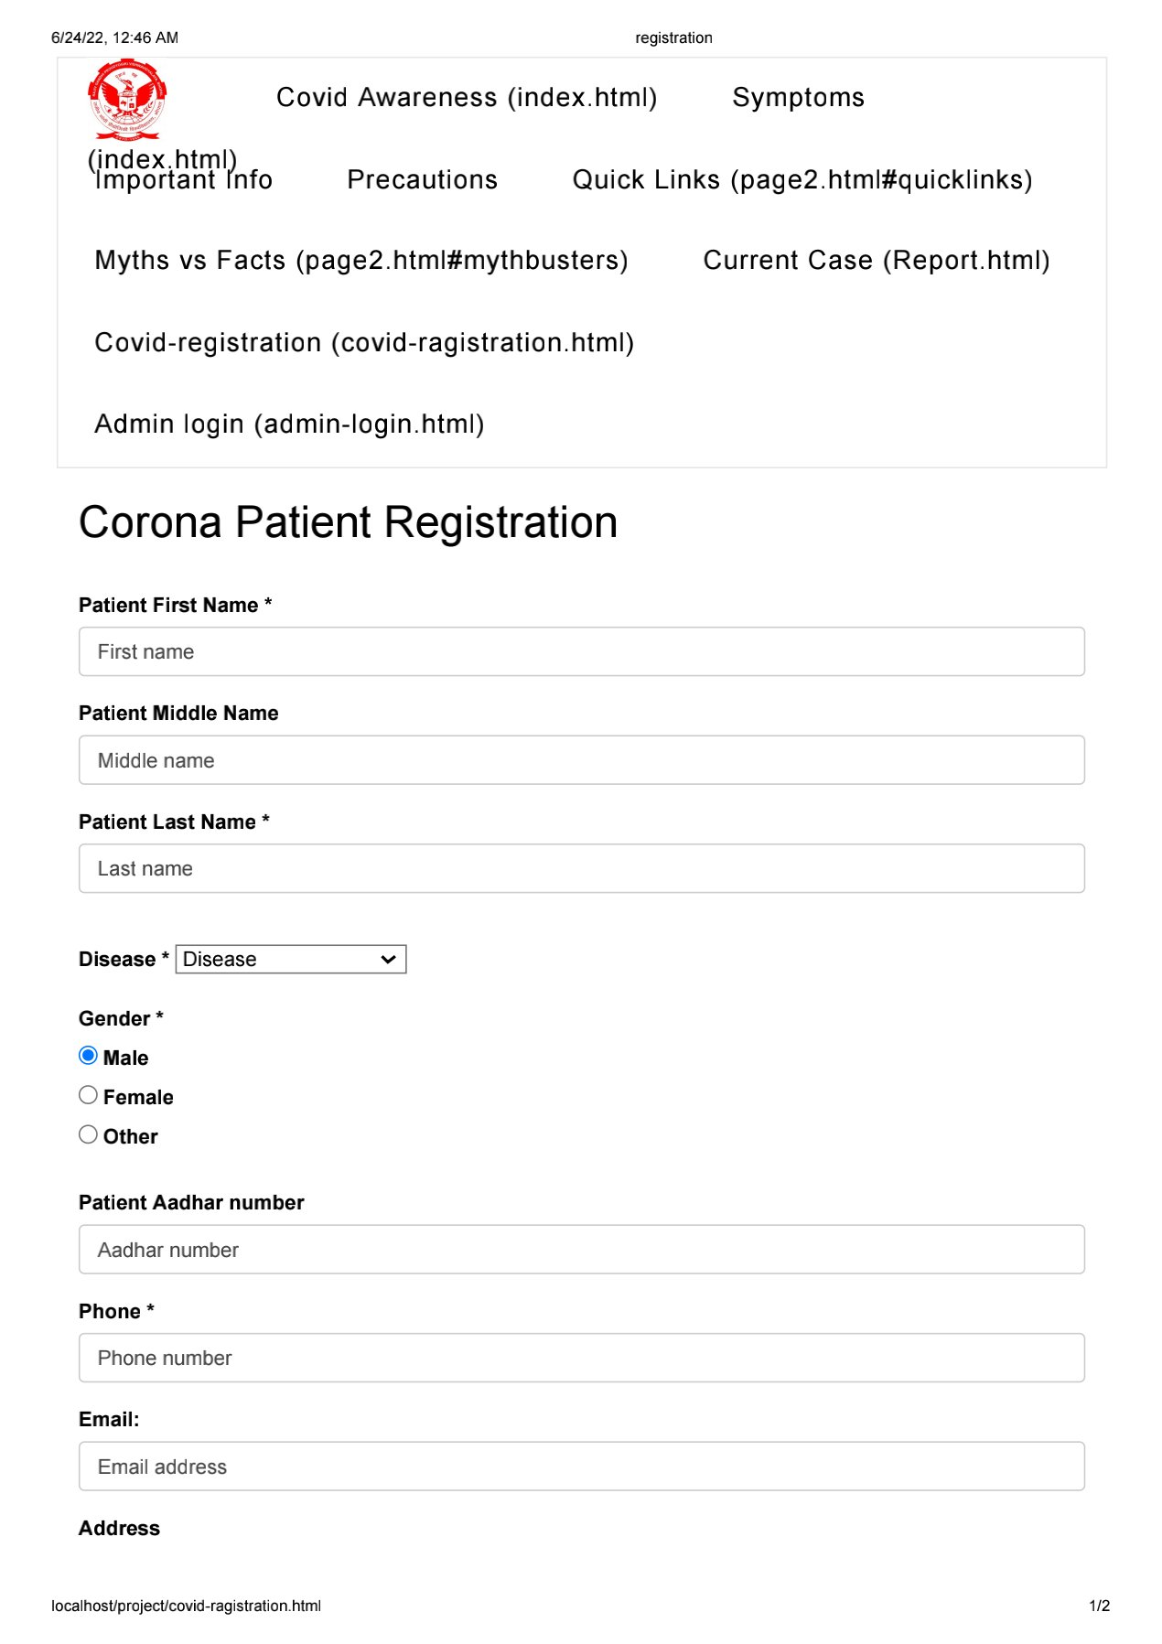
dataflow diagram f0r survey registration
start
Enter the covid survey registraion
Enter all the valid detail on field
Check all field
Enter all the mandatory field
submit
end

Slide 13
Er-diagram
Corona web
Admin
Registration
Email
password
User1
User2
fname
lname
address

Slide 14
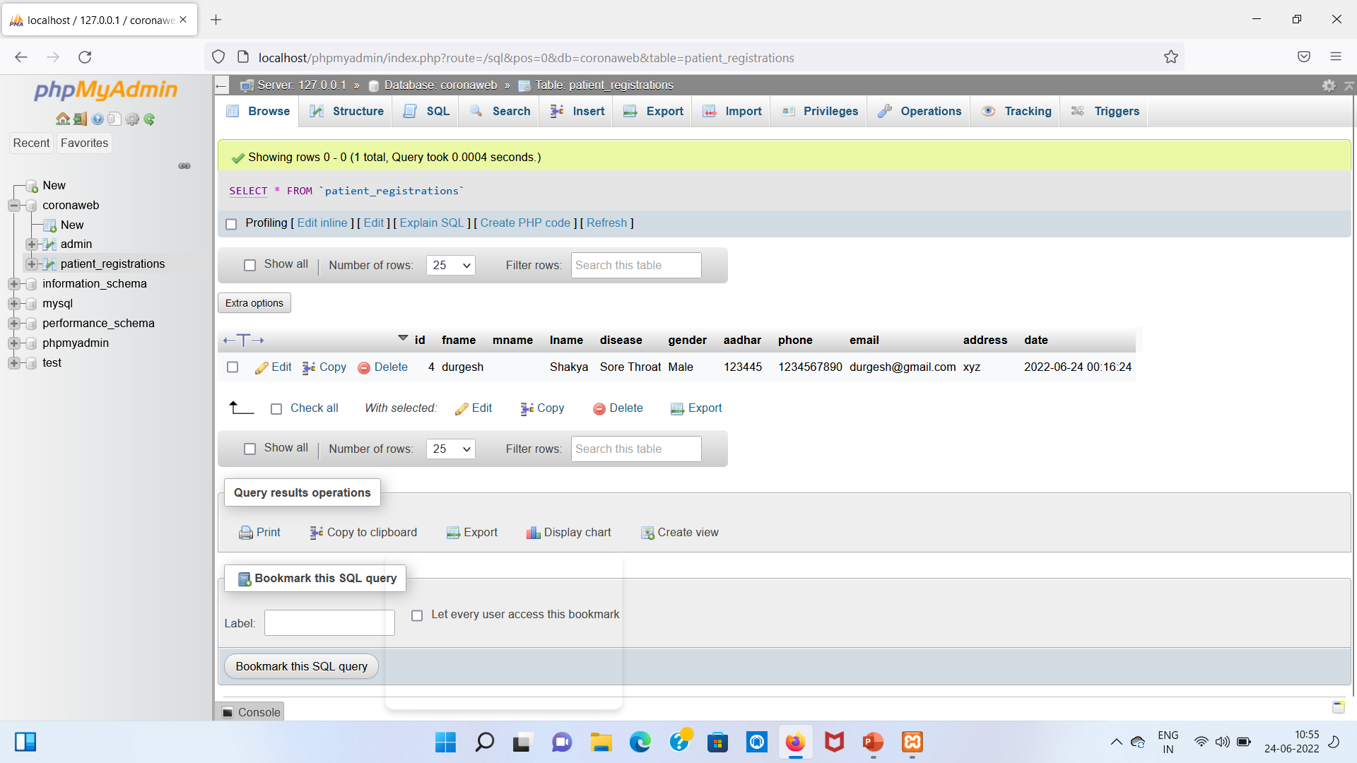
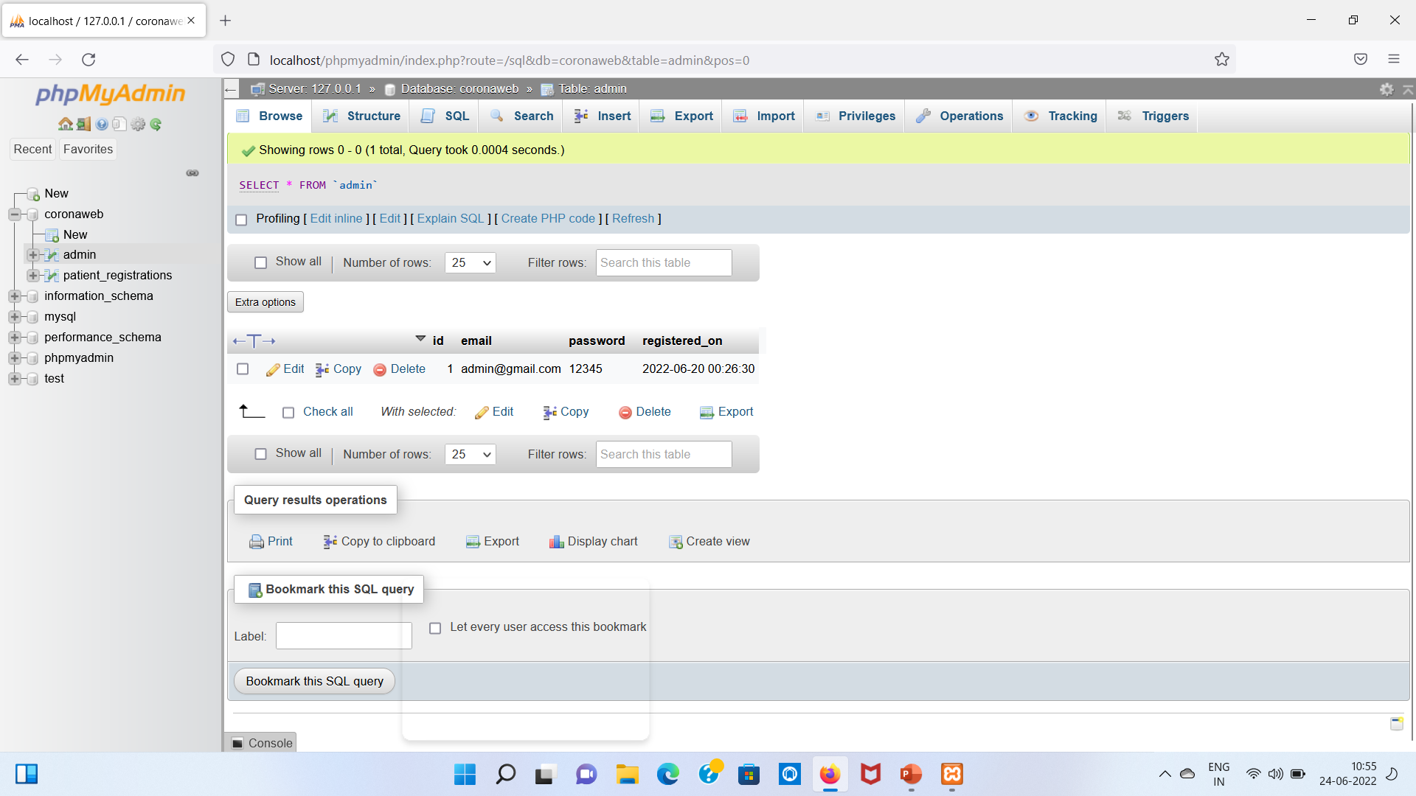
Database screenshot

Slide 15
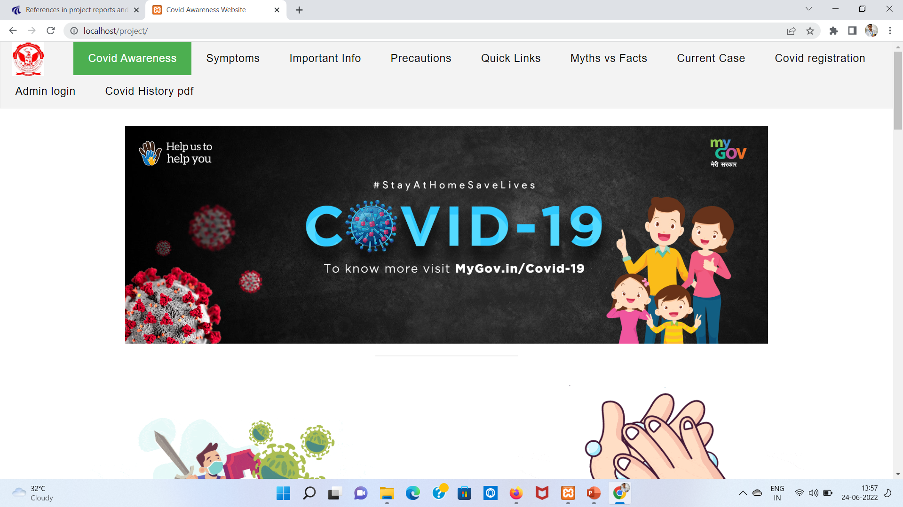
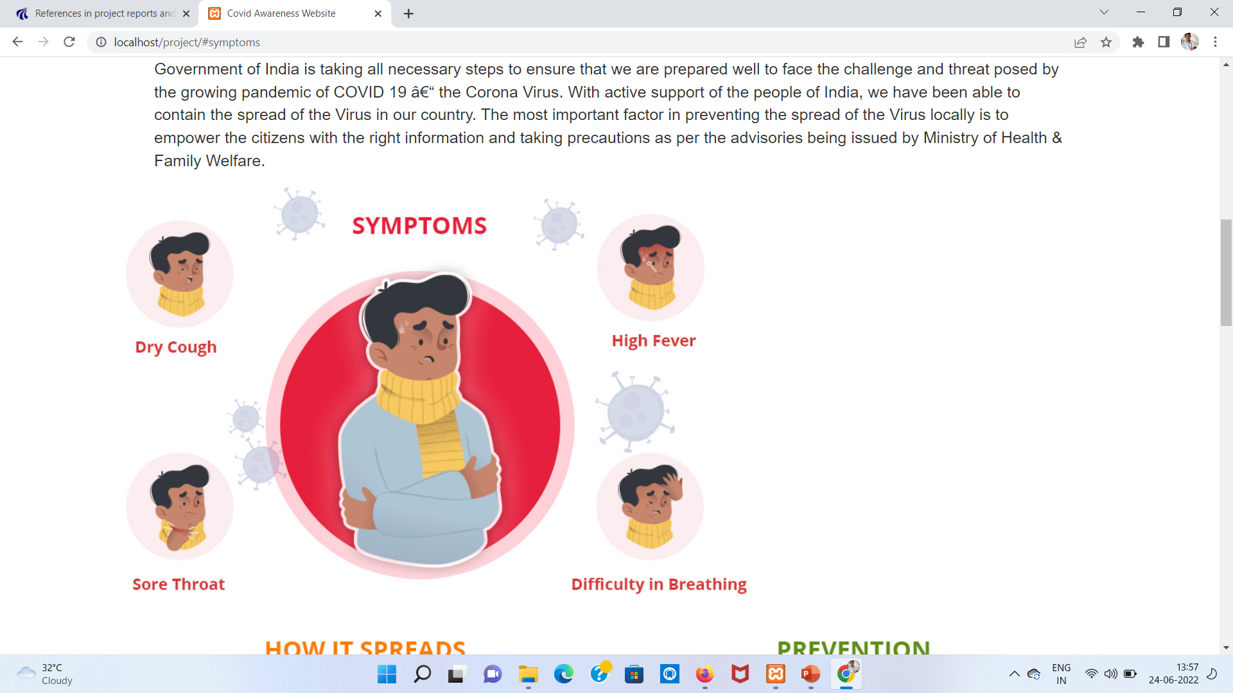
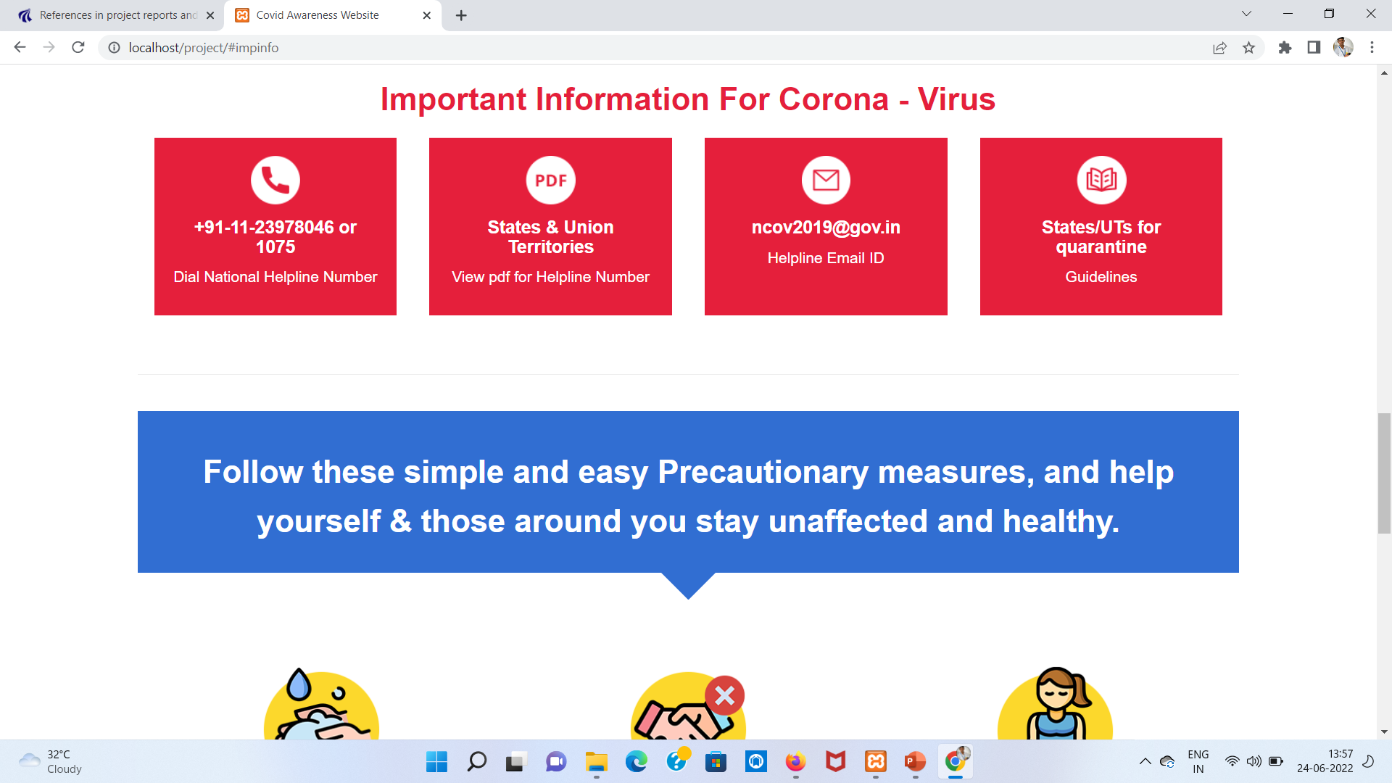
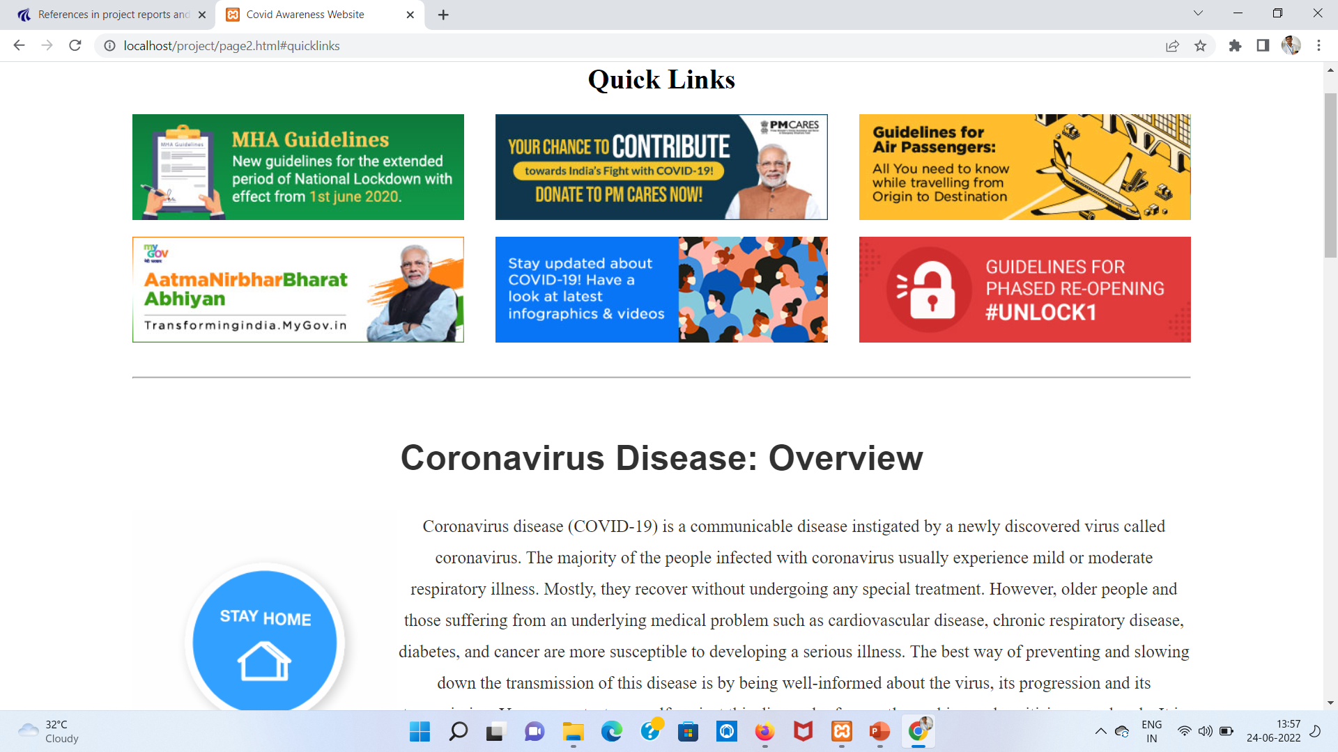
screenshot

Slide 16
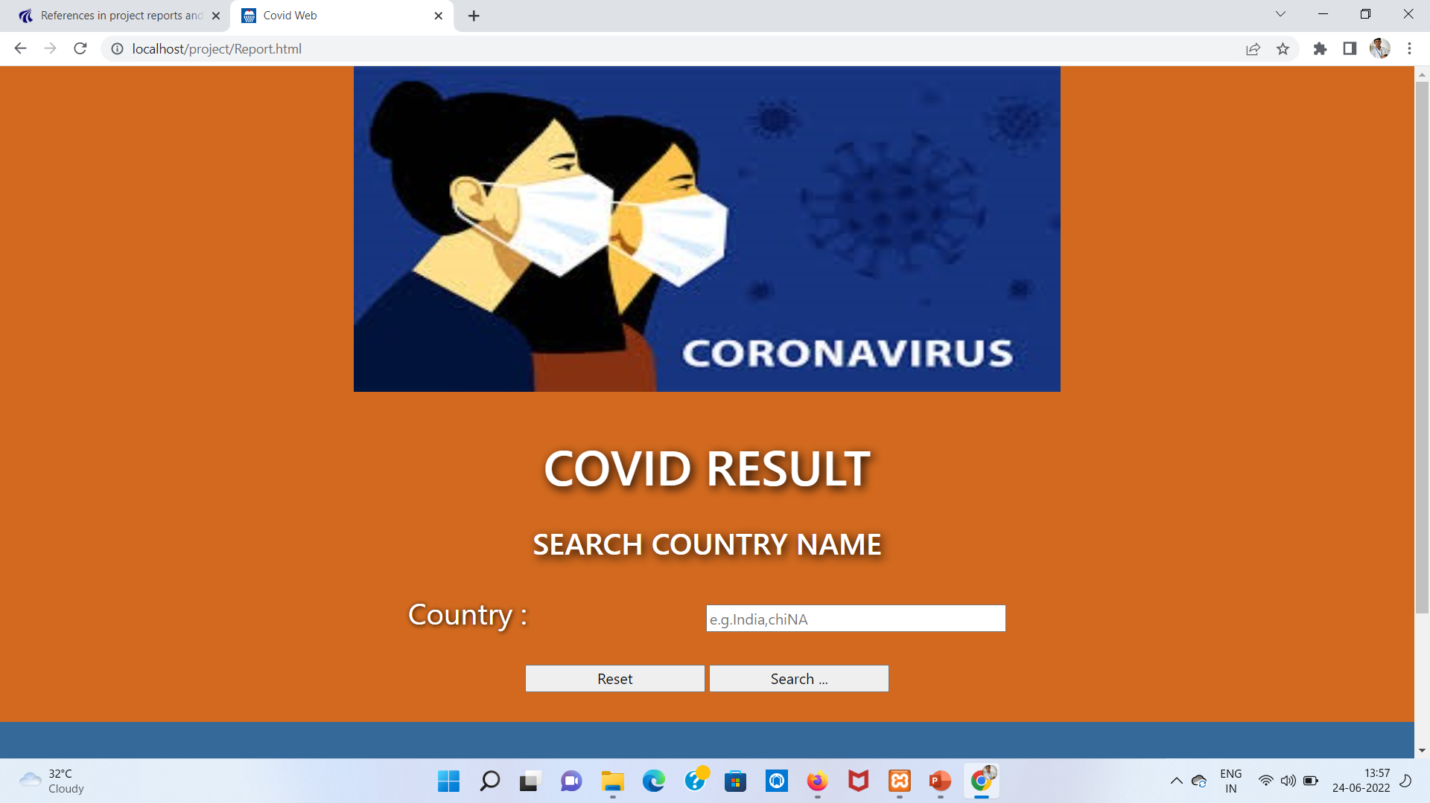
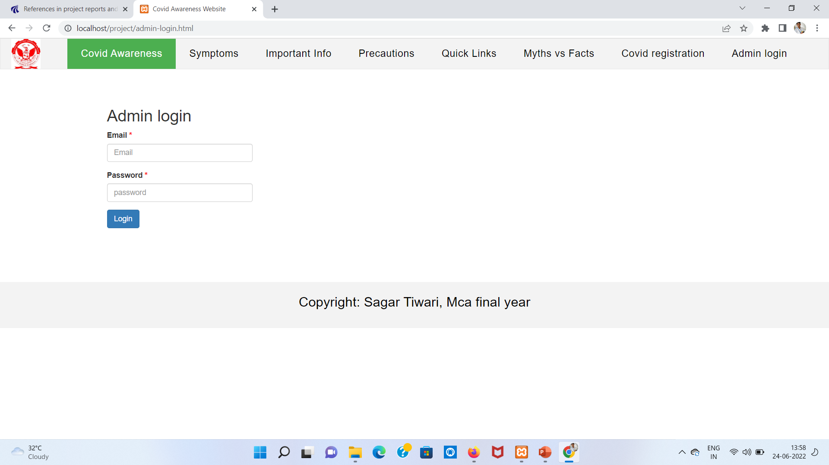

Slide 17
reference
Website:-
https://www.pythonanywhere.com
https://api.covid19india.org
https://www.wikipedia.com
https://www.w3schools.com
https://stackoverflow.com

Slide 18
Thank you all

